Slide 1
Good for the Economy. Good for the Environment.
LIEEAC
Key Federal Laws
Bob Keefe
E2 Executive Director

Slide 2
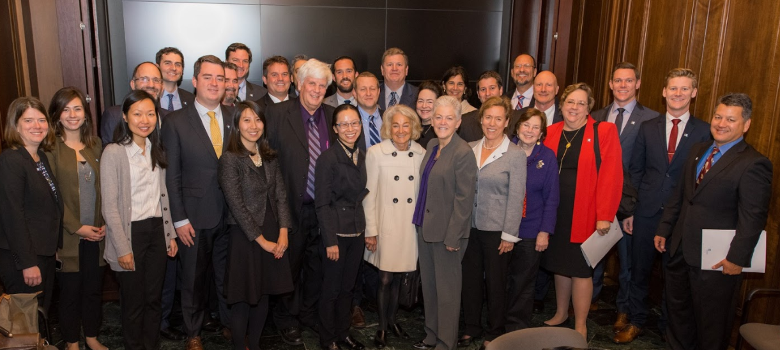
Good for the Economy. Good for the Environment.
10,000+ members and supporters nationwide
9 US chapters, including Midwest
Advocate for policies that are good for the Economy and Environment
E2 members:
Founded or funded 2,500+ companies
Created 600,000+ jobs
Control $100 billion+ in VC/private equity
JOIN US www.e2.org

Slide 3
Good for the Economy. Good for the Environment.
www.climatenomicsbook.com

Slide 4
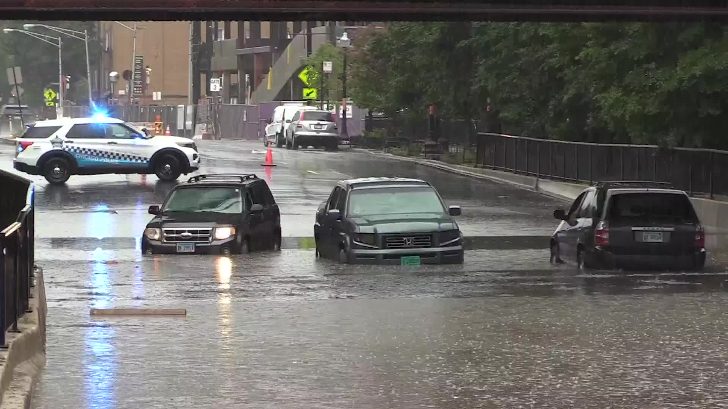
Good for the Economy. Good for the Environment.
Illinois
$1.9 billion average annual cost from climate disasters
1,500 flooding events 2000-2018
38 tornadoes in 2021
20 years ago: Average annual cost $100 million
Notes:
Alternate layout

Slide 5
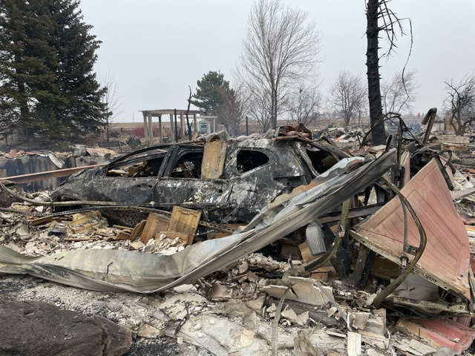
Good for the Economy. Good for the Environment.
United States
$150B+ in climate-related damage 2021
Past five years:
4 most expensive hurricanes
3 most expensive wildfires
Most expensive freeze
Most expensive thunderstorm
Tip of the iceberg:
Homeowners insurance +40% /decade
Fire suppression costs: $4B in 2021/2x 2020
Crop insurance: +$27B additional cost/1991
Notes:
Alternate layout

Slide 6
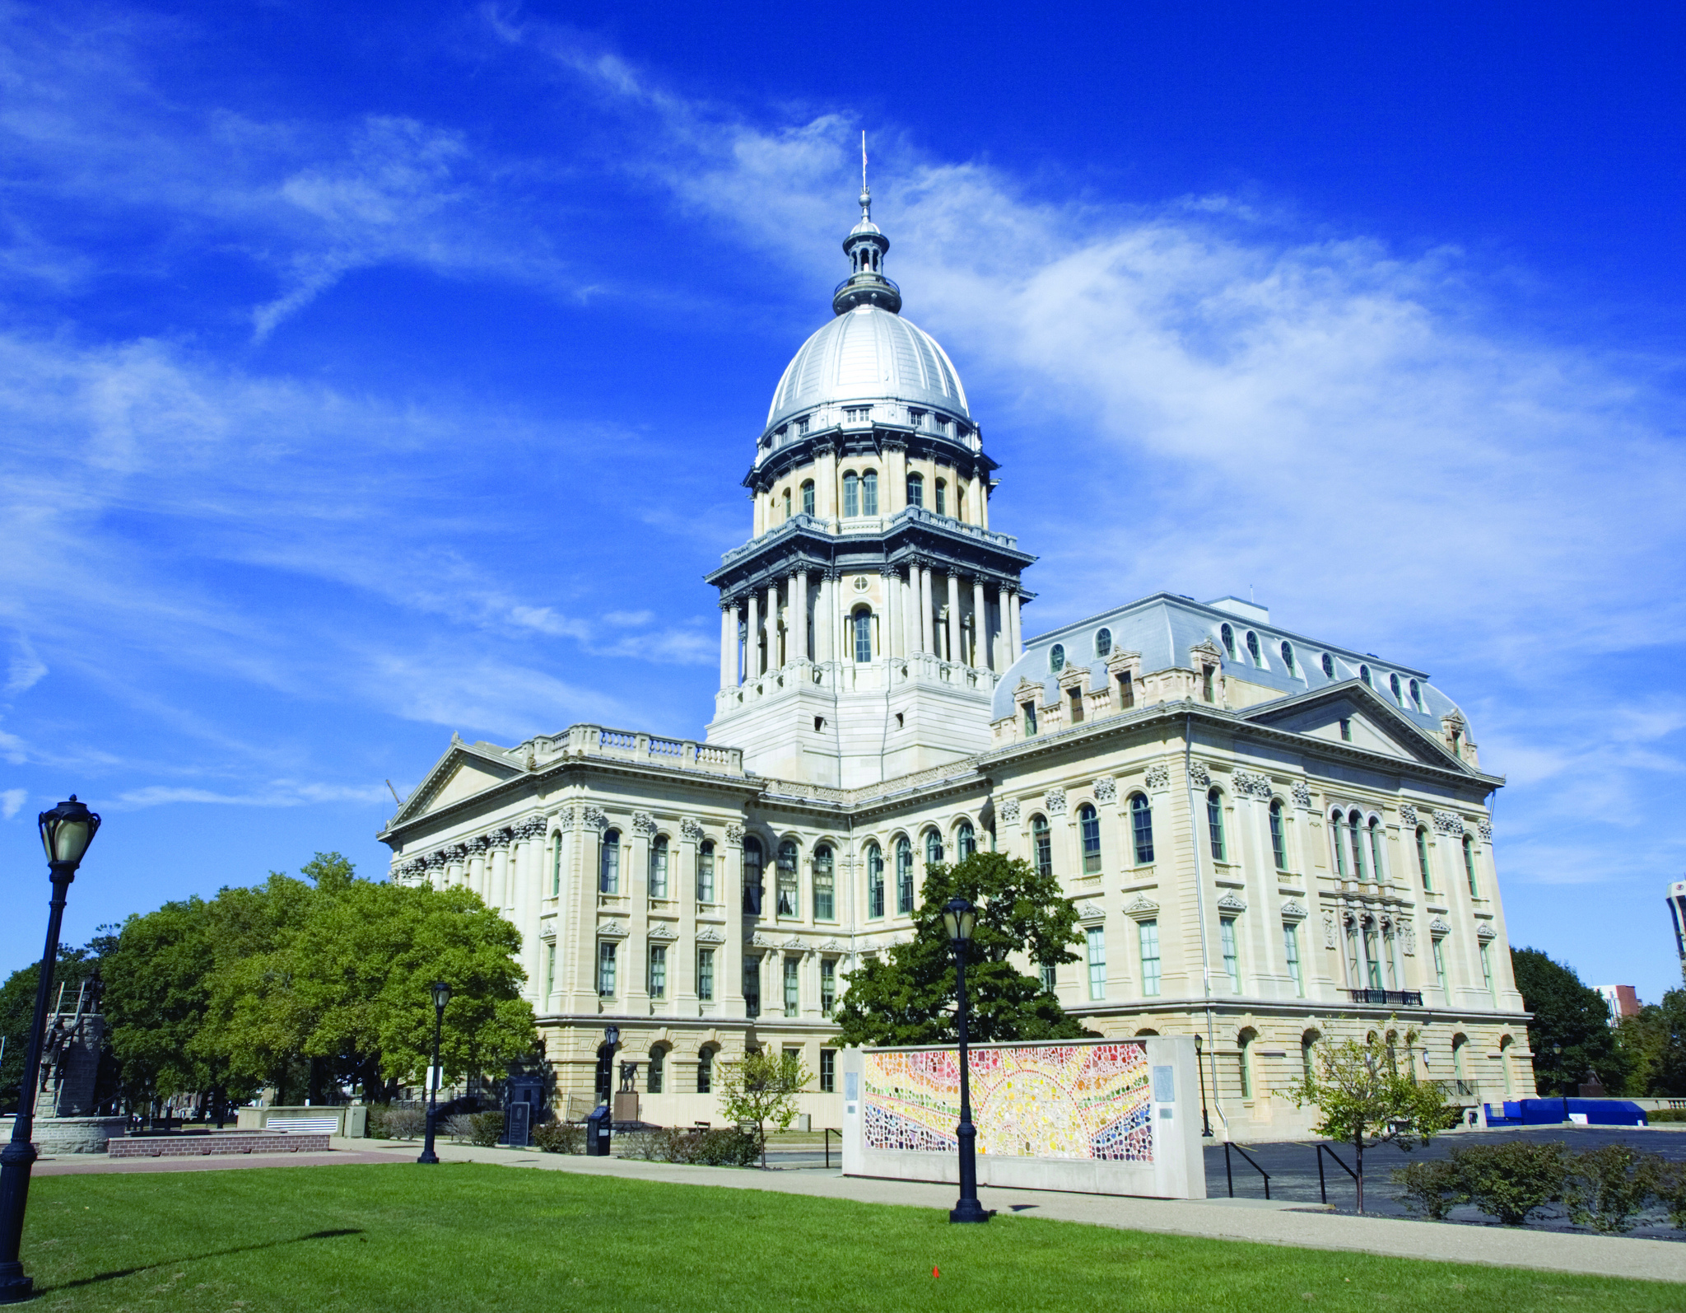
Good for the Economy. Good for the Environment.
Policy Matters
State/Regional level:
Climate & Equitable Jobs Act
Advanced Clean Trucks
Building decarbonization
Federal level:
Infrastructure Investment and Jobs Act
Inflation Reduction Act
Notes:
Alternate layout

Slide 7
Good for the Economy. Good for the Environment.
Infrastructure Investment and Jobs Act
$550 billion, including largest investments ever in
Public transit & passenger rail, bridges ($215B)
Clean drinking water/lead pipes ($55B)
Clean energy transmission ($65B)
EV infrastructure ($7.5B)
Electric buses ($5B)
Notes:
Alternate layout

Slide 8
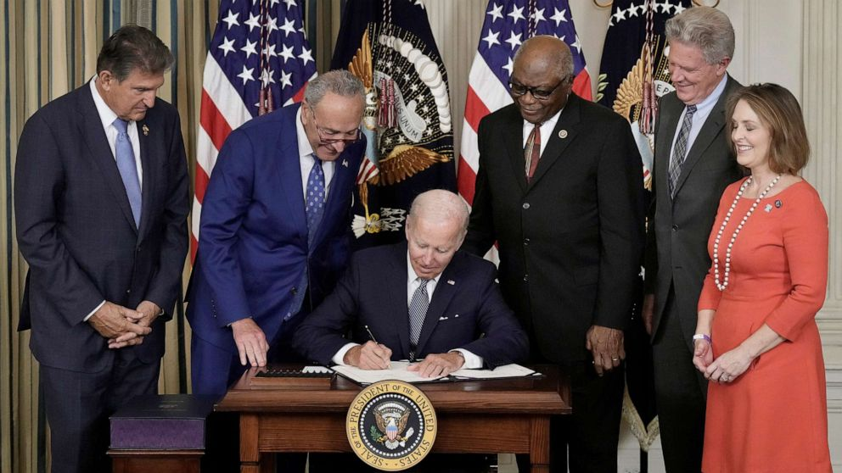
Good for the Economy. Good for the Environment.
Inflation Reduction Act
$370 billion in clean energy tax credits, investments
30% tax credit for renewables, storage/10 years
$7,500/$4,000 tax credits for EVs
$27B Greenhouse Gas Reduction Fund (Green Bank)
Rebates for EE appliances/heat pumps
Notes:
Alternate layout

Slide 9
Good for the Economy. Good for the Environment.
Energy Efficiency Investments under IRA
$54 Billion for EE investments
$15 Billion in EE Tax Credits
25C
45L
179D
REBATES
$4.3 Billion Whole Home Residential EE
$4.275 Billion EE via electrification
Notes:
Alternate layout

Slide 10
Good for the Economy. Good for the Environment.
Inflation Reduction Act – HEEHRA
(High Efficiency Electric Home Rebate Act)
Covers 100% electrification for low-income households; 50% for moderate-income households (up to $14,000)
Heat pump HVAC: $8,000
Heat pump hot water heater: $1,750
Electric stove/cooktop: $840
Heat pump clothes dryer: $840
Installation/box/wiring: $6,500
Average household energy savings: $1,800 per year (heat pump+ heat pump HW heater+ EV+ solar)
Notes:
Alternate layout

Slide 11
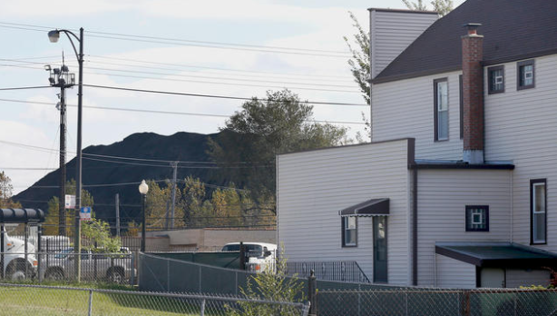
Good for the Economy. Good for the Environment.
Income Qualified Communities
Greenhouse Gas Reduction Fund (Green Bank): 50% of investments in clean energy startups/projects in disadvantaged/income-qualified communities
Solar: 20% bonus tax credit for solar, storage projects in affordable housing, low-income communities; 10% bonus for fossil-fuel dependent communities
New programs for EE and water efficiency in affordable housing developments
EJ community block grants ($3B) to support disadvantaged communities, ports, etc.
Notes:
Alternate layout

Slide 12
Good for the Economy. Good for the Environment.
Illinois
Savings
30% tax credits for clean energy equipment
Grants for state/local building code improvements that would save new Illinois homeowners average of 10% or $194/year
Investments
$18 billion in large-scale clean energy, storage
+280,000 households rooftop solar
Jobs:
Clean energy jobs today: 120,800
Clean energy jobs by 2030: 480,000*
Notes:
Alternate layout

Slide 13
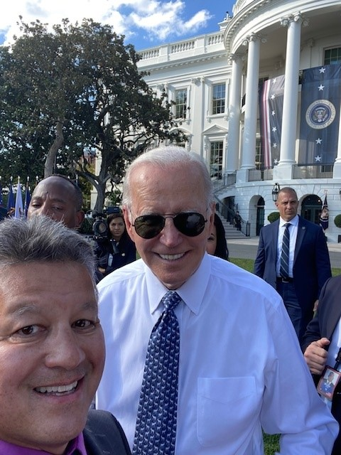
Good for the Economy. Good for the Environment.
You did this
Notes:
Alternate layout

Slide 14
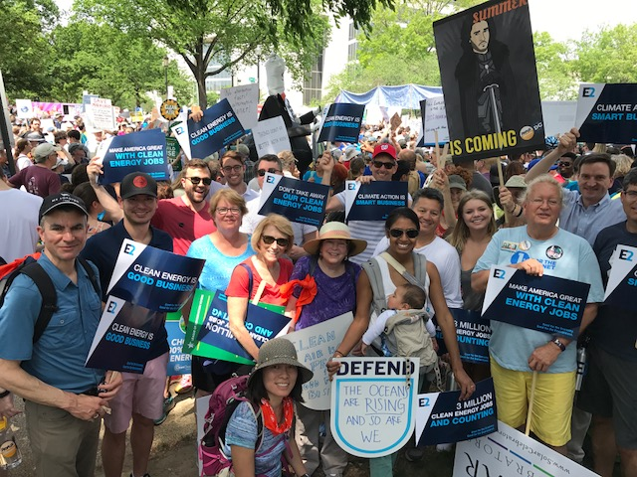
Good for the Economy. Good for the Environment.
www.e2.org
www.climatenomicsbook.com
bkeefe@e2.org
@bkeefee2
Bob Keefe
E2 executive director

